Slide 1
FSBEI HE "Volgograd State Agrarian University"
Method for electrically stimulating poultry meat before freezing
Authors:
Candidate of Biological Sciences Melnikov A.G.
Candidate of Technical Sciences Petrukhin V.A.
Candidate of Biological Sciences Melnikova E.A.
Volgograd, 2020

Slide 2
Purpose of the research
study of the effect of electrical stimulation of poultry meat before freezing and the quality indicators of its samples after thawing

Slide 3
Topicality
One of the main and effective ways to preserve the original properties and quality of meat (meat products) is cold preservation, which distinguishes this method from salting, heating and other technological operations that involve changing them.
Freezing is one of the low temperature preserving methods.
Freezing leads to a change in the physicochemical and technological properties of meat. The peculiarities of changes in meat systems during freezing are determined by the phase transition of water into ice and an increase in the concentration of substances dissolved in the liquid phase.
Most of the loss of juice occurs due to the diffusion of cellular moisture into the intercellular space during slow freezing of cells.
Crystallization of water in the fibers of muscle tissue is characterized by the formation of exit and entry tubules going into the crystal. Crystals that arise during freezing mechanically damage muscle fibers.
When fresh carcasses are cooled and frozen, the development of "cold contraction" of muscles is observed.
Thus, improving the organoleptic characteristics and functional and technological properties of meat after defrosting is an important task.

Slide 4
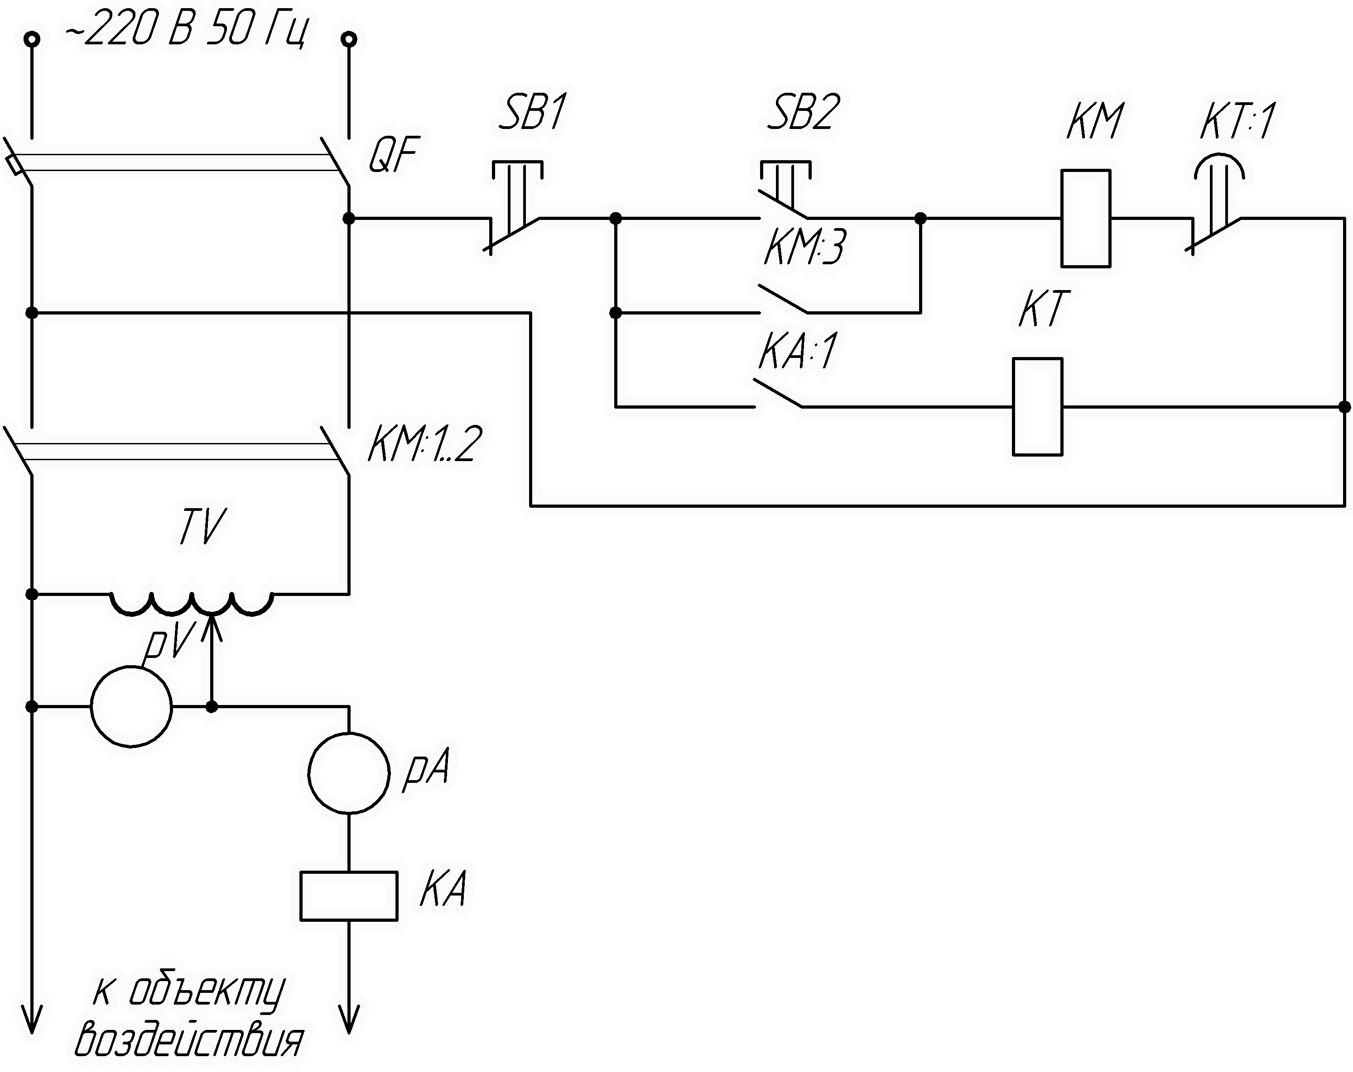
An example of a relay circuit diagram of a device for influencing poultry meat

Slide 5
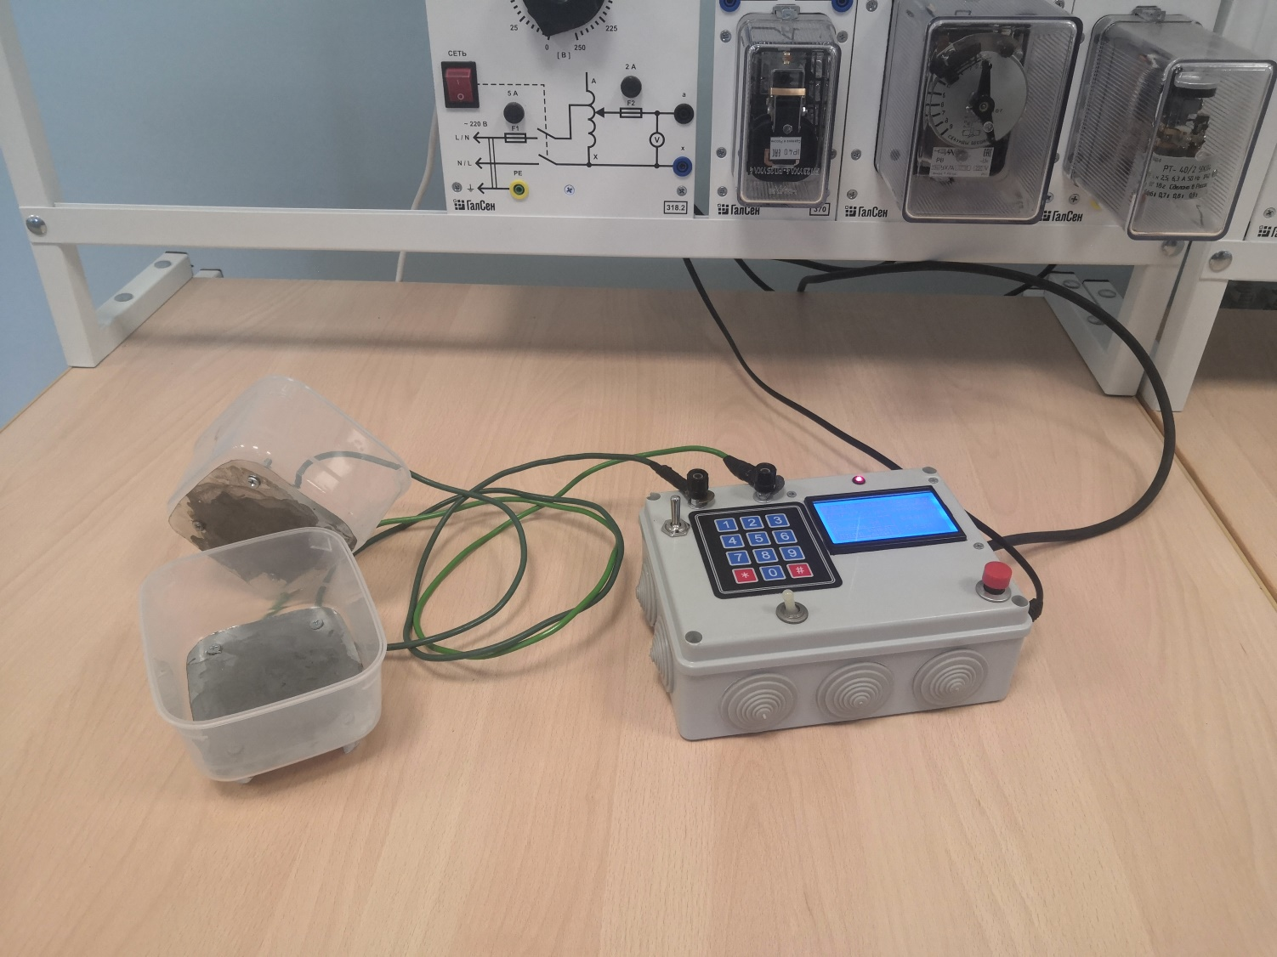
General view of the device
The problem to be solved by the invention is to improve the organoleptic characteristics and functional and technological properties of poultry meat after defrosting.
The technical result is achieved by the method of electrostimulation of meat, including exposure to an alternating electric current of 5A at an industrial frequency of 50 Hz for 15 ... 20 seconds on matured poultry meat before freezing.

Slide 6
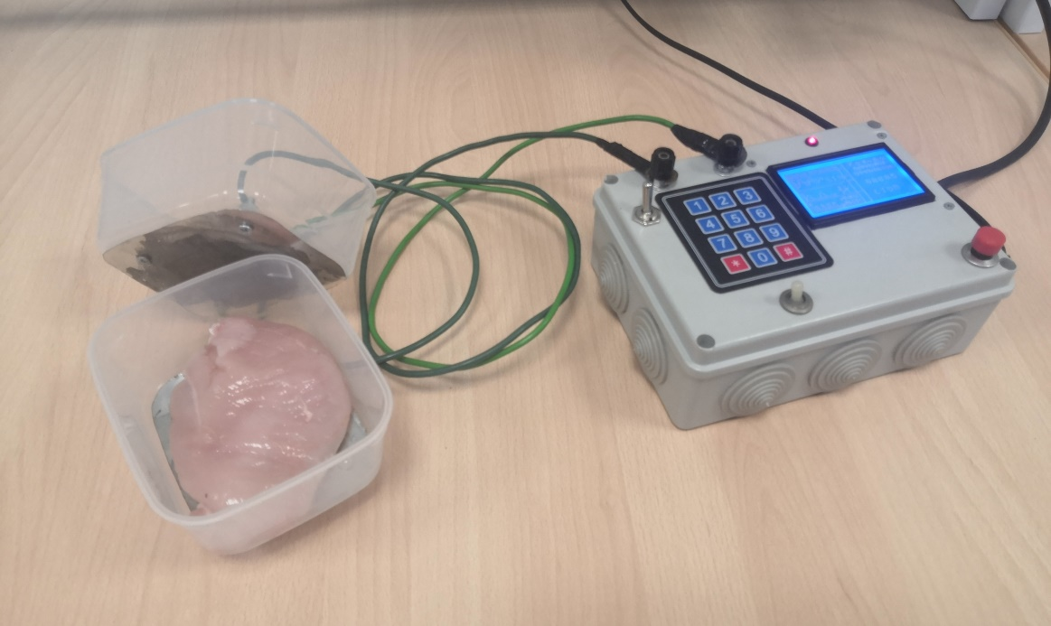
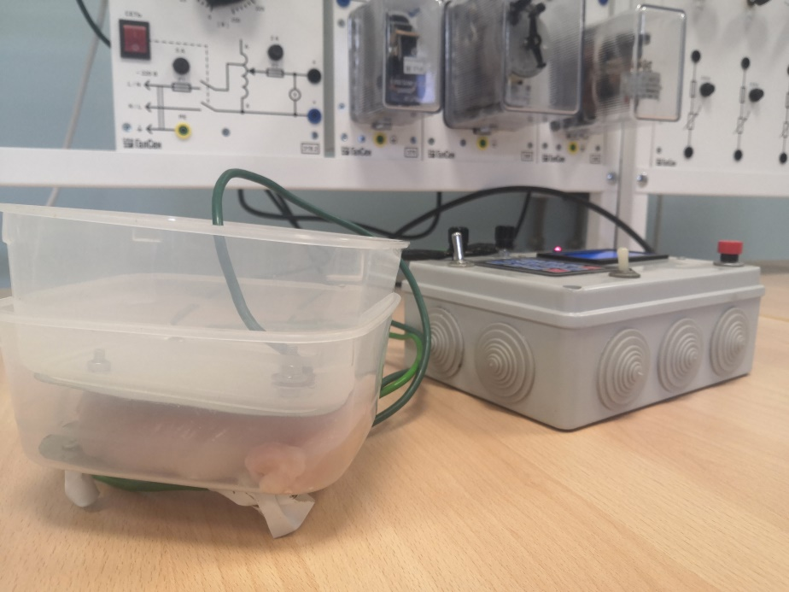
The essential features that ensure the achievement of the declared result are:
- impact on ripened poultry meat before freezing;
- current of industrial frequency 50 Hz;
- exposure duration 15 ... 20 seconds.

Slide 7
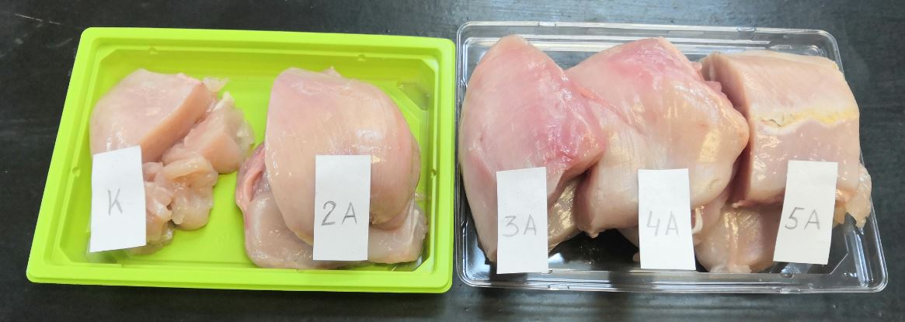
Conducted research
The study was carried out on matured meat from broiler chickens.
Electrical stimulation was carried out at a voltage of no more than 250 V, however, the determining parameter was the current strength. The processing was carried out at the following current values: I₁=2 А (sample No. 1), I₂=3 А (sample No. 2), I₃=4 А (sample No. 3) и I₄=5 А (sample No. 4). The control sample (control) was not stimulated by electric current.

Slide 8
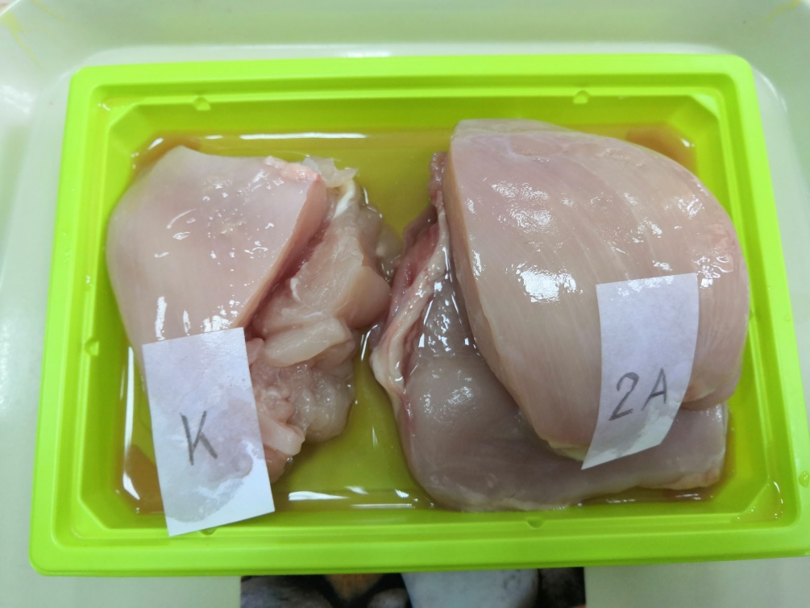
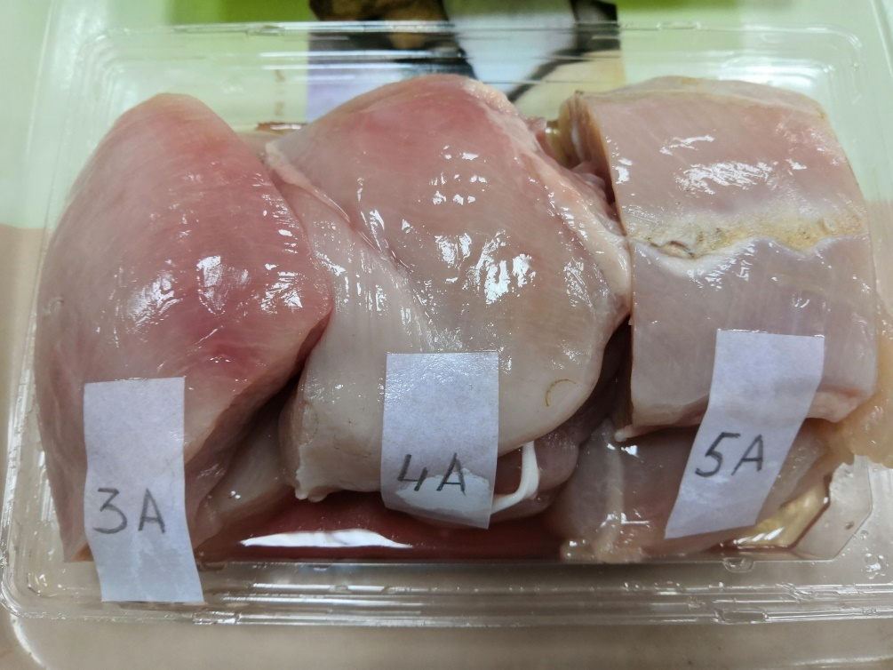
Defrost at room temperature until a temperature in the thickness of the muscles is reached from 1°С to 2°С.

Slide 9
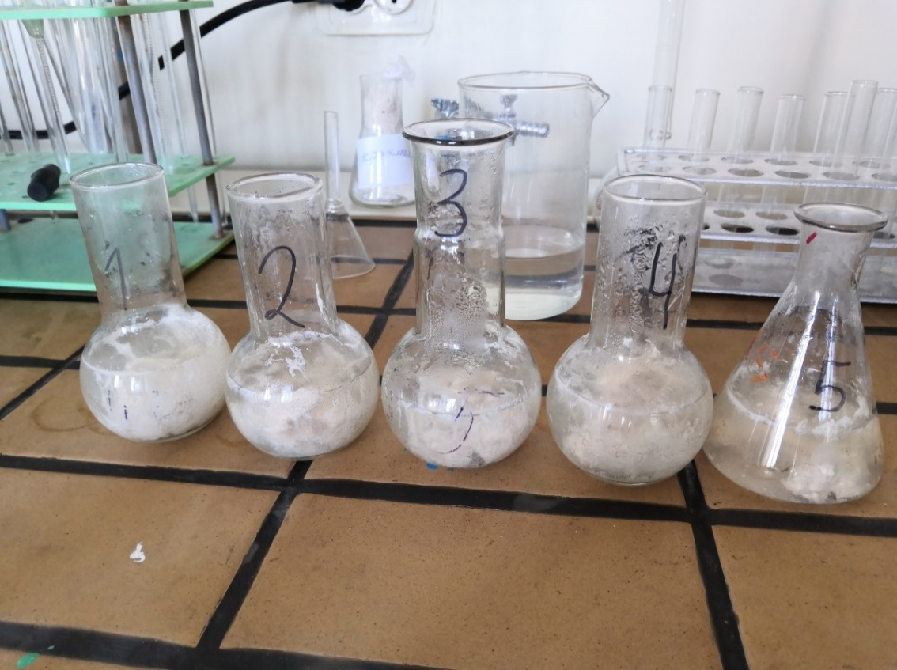
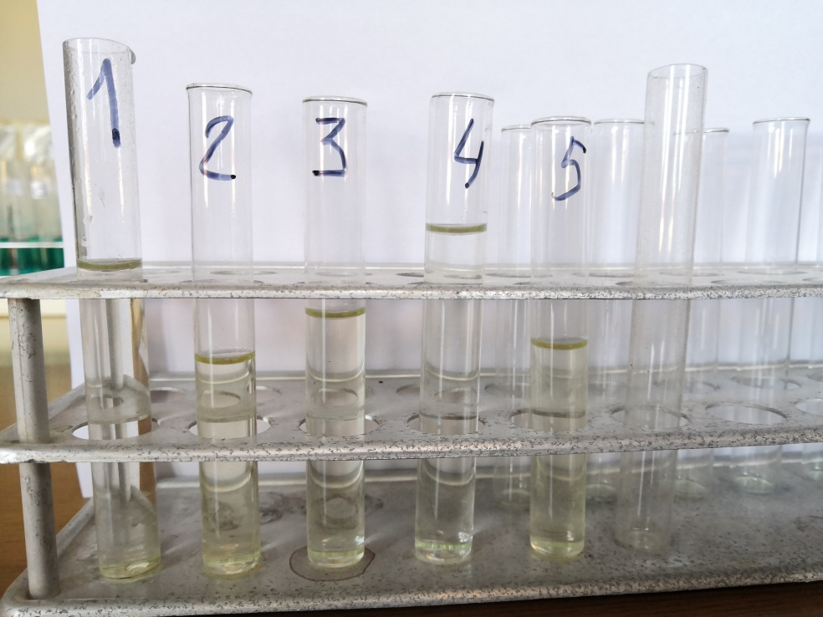
By organoleptic characteristics, after cooking test, all five samples can be attributed to thawed fresh meat.
However, the largest amount of protein flakes was observed in the broth of the control sample, the smallest, in an almost transparent broth, in sample No. 4 (electrical stimulation with a current of 5A), which indicates a better state of protein molecules of meat after defrosting with electrical stimulation with a current of 5A, they were less exposed to coagulation and have great biological value.

Slide 10
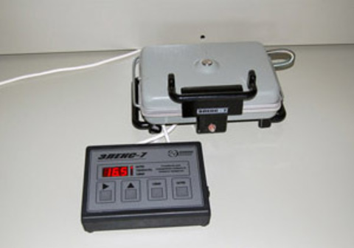
Figure 1 - Mass fraction of moisture in samples,%

Slide 11
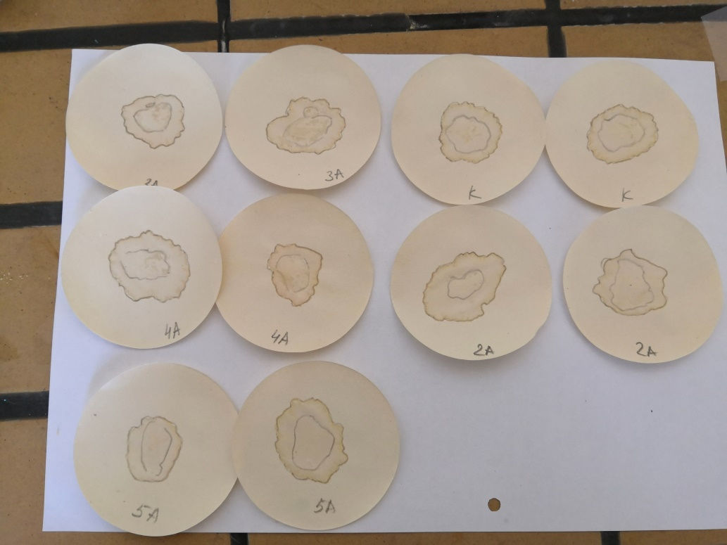
Figure 2 - Indicators of water-binding capacity of samples,%

Slide 12
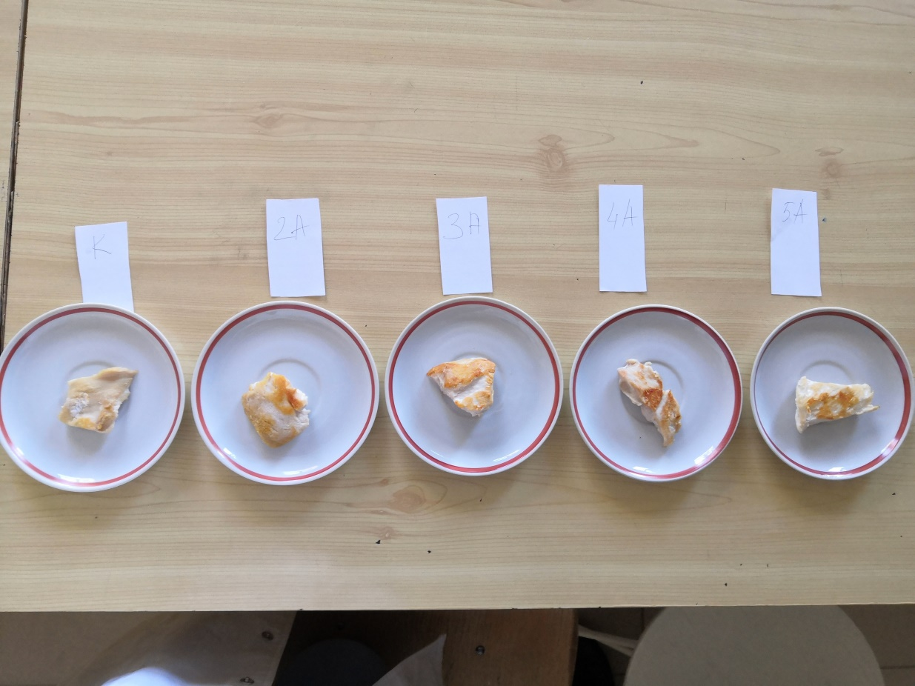
Figure 3 - Indicators of visible roasting of samples,%

Slide 13
Figure 4 - Indicators of the moisture-retaining capacity of samples,%

Slide 14
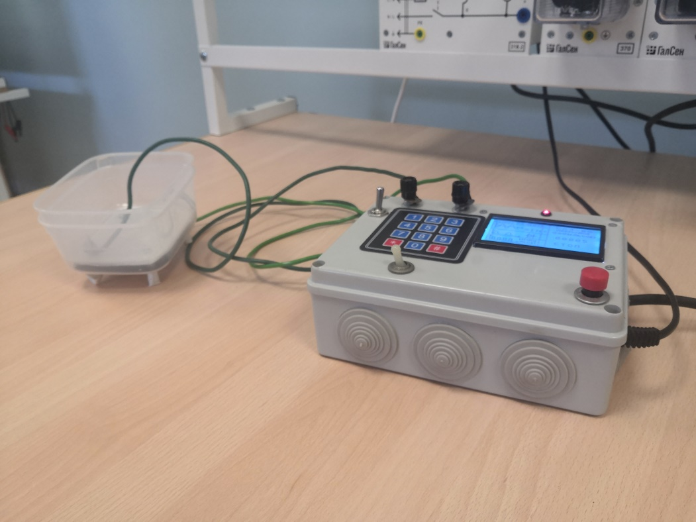
A method of electrostimulation of meat, including exposure to an alternating electric current of 5A at an industrial frequency of 50 Hz for 15 ... 20 seconds on ripe poultry meat before freezing provides an improvement in the organoleptic characteristics of poultry meat after defrosting, in particular the consistency of both raw and heat-treated meat, the acquisition of meat tenderness after heat treatment, improvement of the functional and technological properties of poultry meat after defrosting (water-binding capacity, moisture-retaining capacity, indicator of visible roasting).

Slide 15
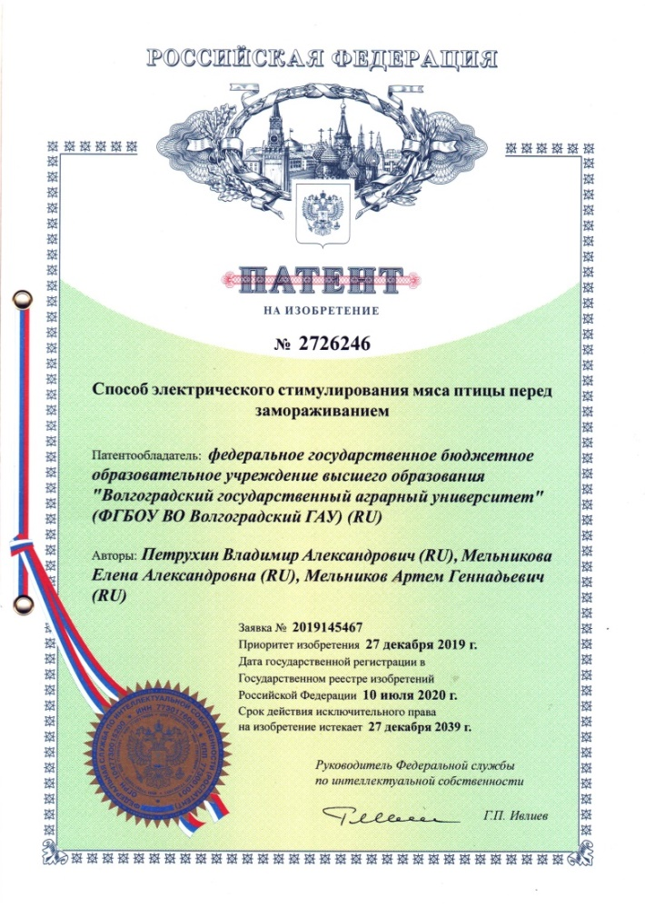
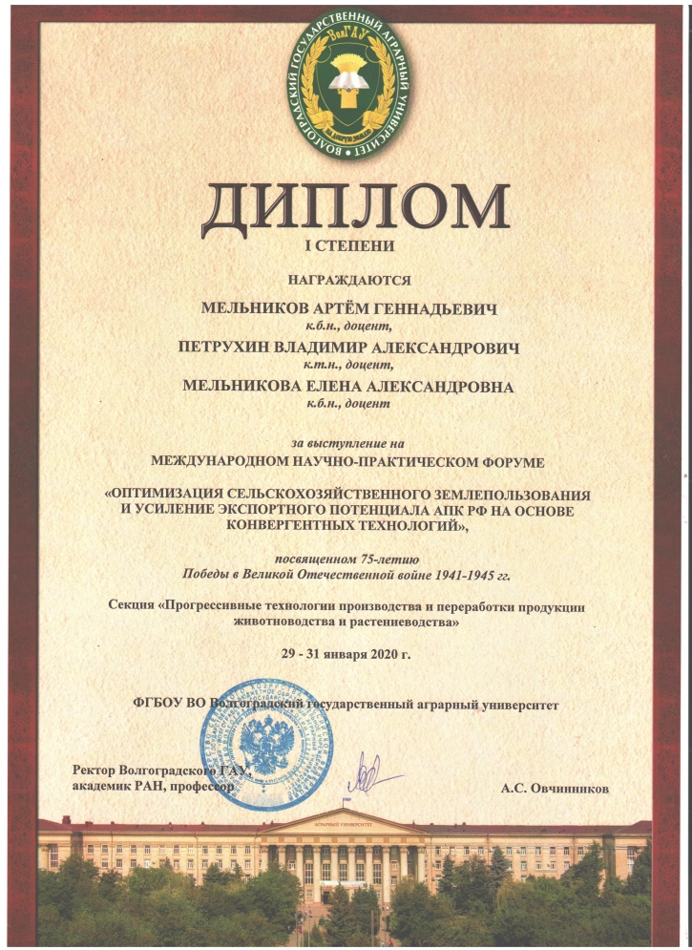
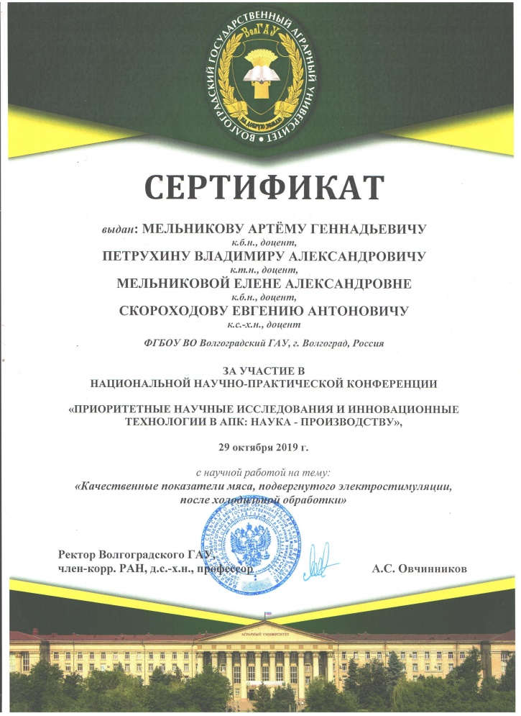
Scientific achievements
Mel’nikov A.G. Qualitative indicators of meat subjected to electrical stimulation after refrigeration / A. G. Mel’nikov, V. A. Petrukhin, E. A. Mel’nikova, E. A. Skorokhodov // Priority research and innovative technologies in the agro-industrial complex: science - production: materials National scientific-practical conference, Volgograd, October 29, 2019 - Volgograd: FSBEI НЕ Volgograd SAU, 2019. - Volume 1. - P. 328-333

Slide 16
Thanks for your attention!

